Slide 1
Students Performance in Exams
DSBA 6520
Professor Robinson
Zhenrong Lao

Slide 2
About the Dataset
1000 observations and 12 variables
1000 students
Student’s information: student_id, gender, race, parental level of education , lunch_type, test_prep , math\reading\writing letter grade.
Dataset Use Case
School would like to know how the students…
How many students pass the test for each test and how many students fail the test for each test?
Is test preparation enough for exam pass?
What’s the main driver of good test scores?
Based on analysis, could we improve the students’ performance in the tests?

Slide 3
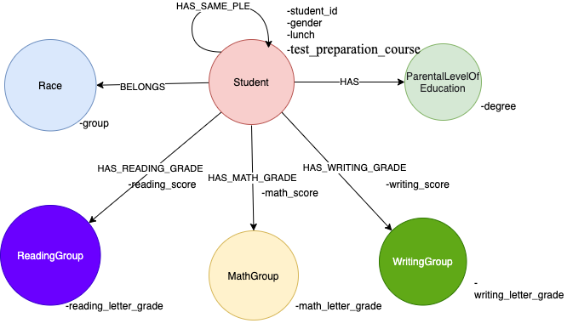
Data Model

Slide 4
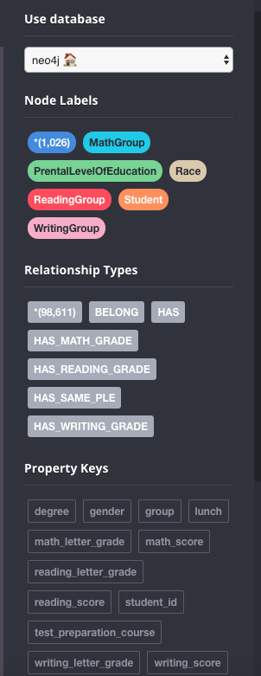
Neo4J Database Setup

Slide 5
Cypher Queries 1
1.1 Math letter grade distribution
MATCH (s:MathGroup)
WITH s,SIZE((s)-[:HAS_MATH_GRADE]-()) AS math_degree
RETURN s.math_letter_grade AS math_letter_grade ,math_degree
1.2 Reading letter grade distribution
MATCH (s1:ReadingGroup)
WITH s1,SIZE((s1)-[:HAS_READING_GRADE]-()) AS reading_degree
RETURN s1.reading_letter_grade AS reading_letter_grade ,reading_degree
1.3 Writing letter grade distribution
MATCH (s2:WritingGroup)
WITH s2,SIZE((s2)-[:HAS_WRITING_GRADE]-()) AS writing_degree
RETURN s2.writing_letter_grade AS writing_letter_grade ,writing_degree
ORDER BY writing_letter_grade
Letter_grade | Math | Reading | Writing
A | 58 | 79 | 78
B | 135 | 170 | 157
C | 216 | 264 | 254
D | 268 | 233 | 230
F | 323 | 254 | 281

Slide 6
Cypher Queries 2
2.1 Total number of student who completed the test preparation course.
MATCH
(s: Student{test_preparation_course:"completed"})
RETURN count(s)
2.2 Number of students who completed the test preparation course and pass the math exam.
MATCH (s: Student{test_preparation_course:"completed"})-[i:HAS_MATH_GRADE]-(m:MathGroup)
WHERE m.math_letter_grade="A" OR m.math_letter_grade='B' OR m.math_letter_grade='C'
RETURN count(s)
2.3 Number of students who completed the test preparation course and pass the writing exam.
MATCH (s3: Student{test_preparation_course:"completed"})-[i:HAS_WRITING_GRADE]-(w:WritingGroup)
WHERE i.writing_score>='70'
RETURN count(s3)
2.4 Number of students who completed the test preparation course and pass the reading exam.
MATCH (s3: Student{test_preparation_course:"completed"})-[i:HAS_READING_GRADE]-(r:ReadingGroup)
WHERE i.reading_score>='70'
RETURN count(s3)
Couse Name | Completed TPR | Math | Reading | Writing
Total Student | 358 | 172 | 223 | 229

Slide 7
Cypher Queries 3
3.1 Number of males who pass the math exam.
MATCH (s1: Student{gender:"male"})- [r1: HAS_MATH_GRADE]- (m1: MathGroup)
WHERE m1.math_letter_grade<>"D" AND m1.math_letter_grade<>"F"
RETURN count(s1) as male_math_pass
3.2 Number of males who pass the reading exam.
MATCH (s2: Student{gender:"male"})- [r2: HAS_READING_GRADE]- (m2:ReadingGroup)
WHERE m2.reading_letter_grade<>"D" AND m2.reading_letter_grade<>"F"
RETURN count(s2) as male_math_pass
3.3 Number of males who pass the writing exam.
MATCH (s3: Student{gender:"male"})- [r3: HAS_WRITING_GRADE]- (m3: WritingGroup)
WHERE m3.writing_letter_grade<>"D" AND m3.writing_letter_grade<>"F"
RETURN count(s3) as male_writing_pass
Gender | Math | Reading | Writing
Male | 231 | 195 | 164
Female | 178 | 318 | 325

Slide 8
Graph Algorithms 1：Weakly Connected Components
CALL gds.graph.create.cypher('student-race-cypher',
'MATCH (n:Student) RETURN id(n) AS id',
'MATCH (p1:Student)-[:BELONG]->(c:Race)<-[:BELONG]-(p2:Student) RETURN id(p1) AS source, id(p2) AS target')
CALL gds.wcc.stream('student-race-cypher')
YIELD nodeId, componentId
RETURN componentId AS component, count(nodeId) AS size
ORDER BY size DESC
 | Component | Size
1 | 1 | 319
2 | 8 | 262
3 | 0 | 190
4 | 32 | 140
5 | 3 | 89

Slide 9
Graph Algorithms 2：Louvain
CALL gds.graph.create('student-PLE','Student','HAS_SAME_PLE')
CALL gds.louvain.stream('student-PLE')
YIELD nodeId, communityId
RETURN communityId, COUNT(DISTINCT nodeId) AS size
ORDER BY score DESC
 | CommunityId | Degree | Size
1 | 638 | some college | 226
2 | 147 | associate’s degree | 222
3 | 682 | high school | 196
4 | 775 | some high school | 179
5 | 862 | bachelor’s degree | 118
6 | 567 | master’s degree | 59

Slide 10
Algorithms 3: Node Similarity
CALL gds.graph.create('student-grade', ['Student', 'MathGroup', 'ReadingGroup', 'WritingGroup'], '*')
CALL gds.nodeSimilarity.stream('student-grade',{degreeCutoff: 20})
YIELD node1, node2, similarity
RETURN gds.util.asNode(node1).student_id AS student1 , gds.util.asNode(node2).student_id AS student2, similarity
ORDER BY similarity DESC
LIMIT 4
 | Student 1 | Student 2 | Similarity
1 | 805 | 284 | 0.9955357142857143
2 | 284 | 805 | 0.9955357142857143
3 | 98 | 721 | 0.995475113122172
4 | 721 | 98 | 0.995475113122172

Slide 11
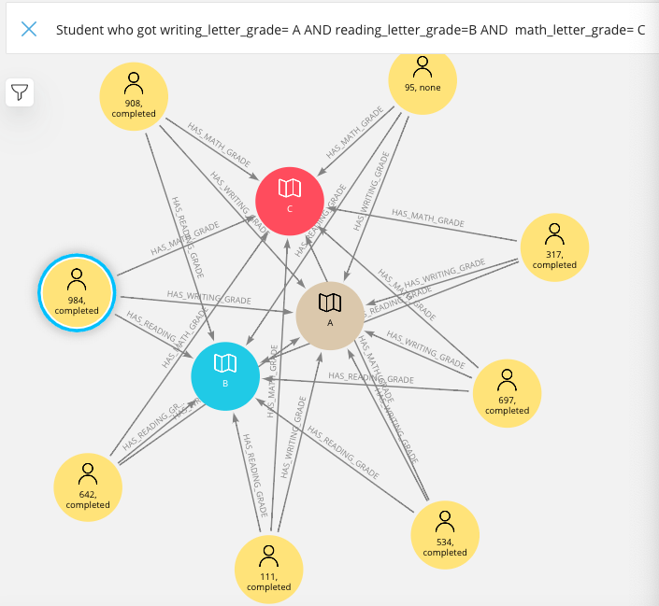
Cypher Action 1
Search Phrase: Student who got writing_letter_grade=$writing_letter_grade and reading_letter_grade=$reading_letter_grade and w3. math_letter_grade= $math_letter_grade
Description: Find students who perform similar in all three exams or students are in the same set of grade letters for all exams

Slide 12
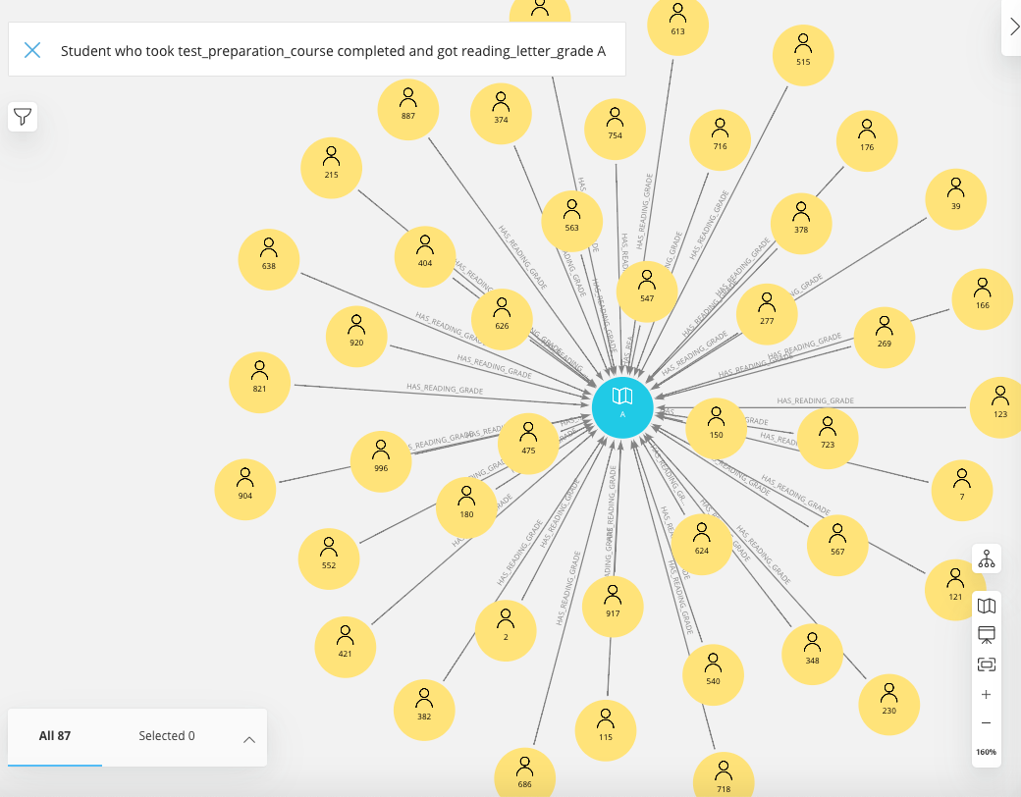
Cypher Action 2
Search Phrase: Student who took test_preparation_course $test_preparation_course and got reading_letter_grade $reading_letter_grade
Description: Find Student who perform good at one exam and complete the test preparation course.

Slide 13
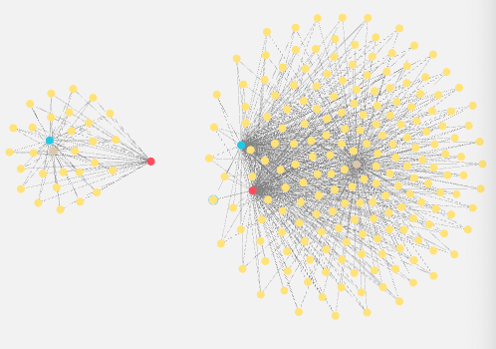
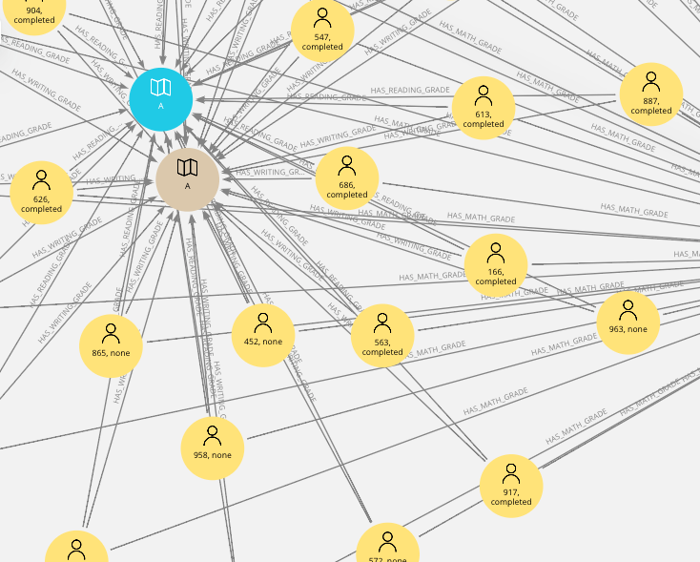
Graph Visualizations 1

Slide 14
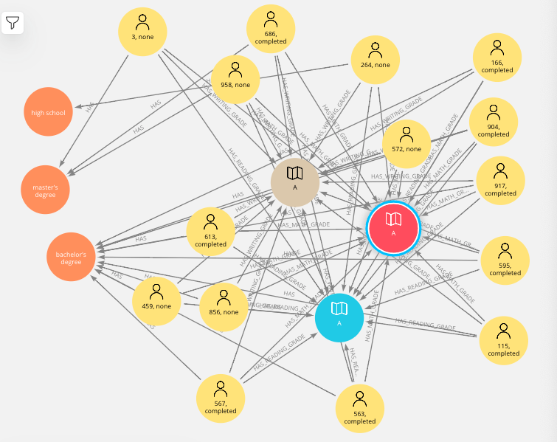
Graph Visualizations 2

Slide 15
Summary
Female are ahead of male in reading and writing scores, but in math scores male is higher than female.
Meal is important, hence if we look closely when lunch is provided math score is comparatively higher than lunch is absent.
Reading, writing, math score is found to be more in race/ethnicity group C and lowest in race/ethnicity group A.
Surprisingly, reading, writing and math scores is found to be more where parental level of education is some college and lowest where parental level of education is master's degree.

Slide 16

ANY QUESTIONS

